Slide 1
Topical Review 3
Center and Spread, Normal Distribution, Sample Means, CLT

Slide 2
Center and Spread

Slide 3
Center and Spread
Two important aspects/values of a histogram
Center (mean)
Variability (standard deviation)
Mean
np.mean(array)
Variability
Standard Deviation: root mean squared deviations from the average
np.std(array)
np.sqrt(np.mean( (array - array_{mean}) ** 2 )
Standard Units:
(array - array_{mean}) / array_{SD}
Useful for making comparisons of values that belong to different units of measurement
Notes:
Why does center and spread matter? These are two ways that we can describe our histogram.
Center = mean, Spread = variability
Mean is something trivial and we’ve seen it a lot before
Use np.mean to calculate the mean of a collection of data (array)
The mean doesn’t tell us a whole lot of interesting info about our histogram though, because it’s just a single number
Variability deals with the deviations from the average
This can tell us how far apart the values tend to be from the average
Can think of variability being an additional value/characteristic of our data that helps us to draw a more accurate histogram, one that reflects how spread out the values within the collection are
Standard Deviation
Also known as “root mean squared of deviations from the average”
The np function makes it easy to calculate the SD of an array
Standard Units
Now any value of the dataset can be defined by its deviation from the average, or the number of SD’s it is from the average
A value rewritten in standard units is equal to the (value - average of the data) / SD of the data
Chebychev’s Bounds
Some specific numbers
the proportion in the range "average ± 2 SDs" is at least 1 - 1/4 = 0.75
the proportion in the range "average ± 3 SDs" is at least 1 - 1/9 ≈ 0.89
the proportion in the range "average ± 4.5 SDs" is at least 1 - 1/ 4.524.52 ≈ 0.95

Slide 4
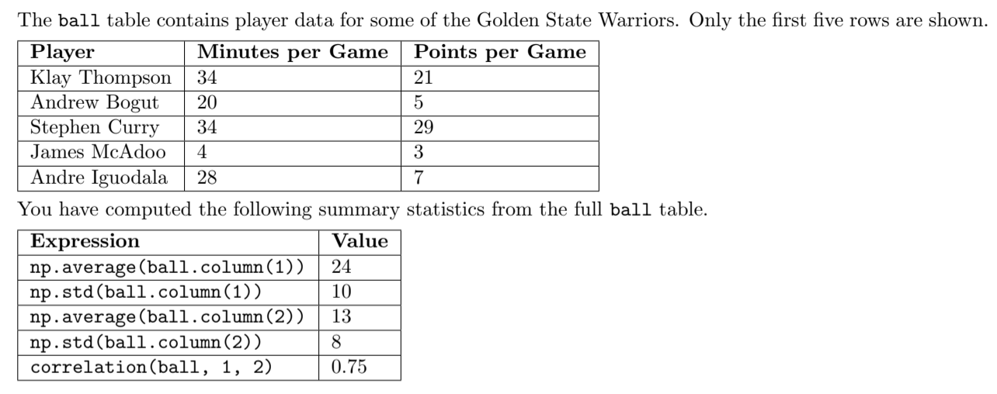
Practice
If Stephen Curry average points per game in standard units is 2, then what is Andrew Bogut’s average points per game in standard units?
If Stephen Curry average points per game in standard units is 2, then what is Andrew Bogut’s average points per game in standard units?

Slide 5
Practice
If Stephen Curry average points per game in standard units is 2, then what is Andrew Bogut’s average points per game in standard units?
If Stephen Curry average points per game in standard units is 2, then what is Andrew Bogut’s average points per game in standard units?
Value in Standard Units = (Value - average) / SD
Stephen Curry: 29 points per game 2 = 29 - 13 / SD 2 = 16 / SD SD = 8 for points per game | Andrew Bogut: 5 points per game Standard Units = 5 - 13 / 8 SU = -8 / 8 SU = -1

Slide 6
Practice
What range of minutes per game includes at least 75% of all the distribution data?

Slide 7
Practice
What range of minutes per game includes at least 75% of all the distribution data?
According to Chebyshev's bounds, the proportion in the range “average ± 2 SDs is at least 1 - 1/4 or roughly 75%
24 ± (2 x 10) → 4 minutes - 44 minutes

Slide 8
Normal Distribution

Slide 9
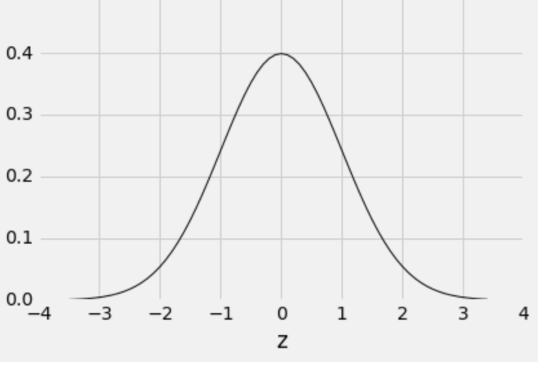
Normal Distribution
Properties:
Symmetric
Mean = Median
1 SD = distance between mean and points of inflection
The area under the curve is 1.
Note that the horizontal axis is represented in standard units.

Slide 10
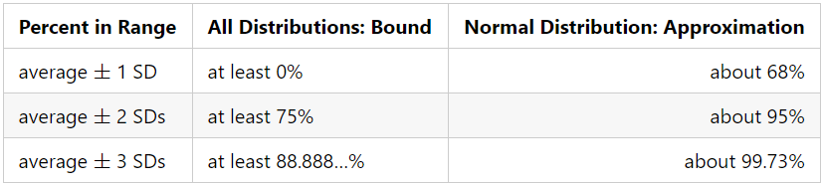
Normal Distribution: Why do we care?
The percent of values within some # SDs from the mean can be approximated using the table
Bound is much tighter than Chebychev’s (the center column)
Useful for calculating confidence interval if the Central Limit Theorem (CLT) applies to the chosen statistic!
Notes:
tl;dr - normal distribution is special and C O O L
Chebychev’s bounds work with any histogram regardless of distribution
As a result, the estimations for the proportion of the data that lies within those bounds is more “general”
Bounds are more specific for normal distribution
Can provide better estimates for the amount of data that lie between z number of SDs
“Average ± 2 SDs” being about 95% of a normal distribution is useful
Think: 95% confidence intervals for distributions that we know to be normal

Slide 11
Discussion Questions
Intuitively, why are standard units useful?
If a histogram is bell-shaped, what assumptions can we make?

Slide 12
Discussion Questions
Intuitively, why are standard units useful?
Standard units are useful for placing different measurements on the same scale, allowing for easier comparison
If a histogram is bell-shaped, what assumptions can we make?
Mean and median are equal and at the center
SD is the distance between the average and points of inflection on either side of the curve.
About 68% of data within 1 SD of center, 95% within 2 SDs, 99.7% within 3 SDs
Notes:
Average is the center, mean = median, the distribution is symmetrical about the mean/median.
“how many SDs above the average" -- normal distribution helps us answer this fundamental question.
Reference impact of mean and medium when histogram has a tail.

Slide 13
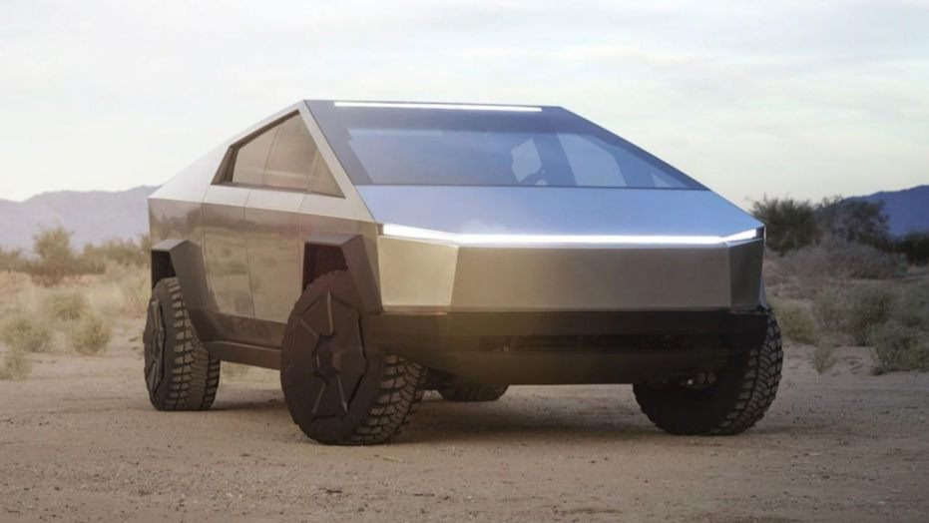
Practice Problem #1
Vehicle Prices are normally distributed with a mean price of $36,000 and a SD of $10,000. If a random car is chosen, what is the approximate probability that the car costs less than $26,000?
Note: the Tesla Cybertruck does not cost less than $26,000

Slide 14
Practice Problem #1 [Solution]
Vehicle Prices are normally distributed with a mean price of $36,000 and a SD of $10,000. If a random car is chosen, what is the approximate probability that the car costs less than $26,000?
0.16: Remember, 68% of values will be within 1SD of the average in a normal distribution.
Note: the Tesla Cybertruck does not cost less than $26,000

Slide 15

Practice Problem #2
The number of students entering Moffitt Library daily is normally distributed with an average¹ of 5000 and a SD of 150. If Greg and Gregory visited Moffitt on a random day, what is the approximate probability that the number of students they saw was less than 5300?
1. Shoutout to Caroline Chen for coming up with this estimate
2019: A Cal student enters Moffitt (colorized)

Slide 16
Practice Problem #2 [Solution]
The number of students entering Moffitt Library daily is normally distributed with an average¹ of 5000 and a SD of 150. If Greg and Gregory visited Moffitt on a random day, what is the approximate probability that the number of students they saw was less than 5300?
0.975: Remember, we want to look at all the data to the left of the point that is +2 SDs away from the mean.
1. Shoutout to Caroline Chen for coming up with this estimate
2019: A Cal student enters Moffitt (colorized)

Slide 17
Central Limit Theorem

Slide 18
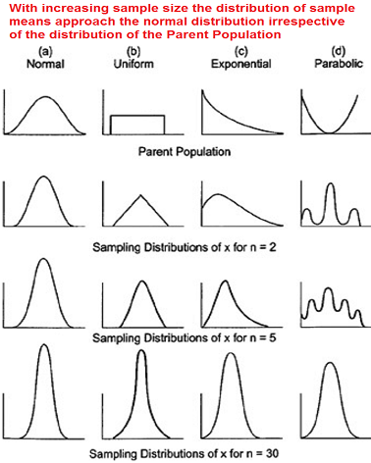
Central Limit Theorem (CLT)
The probability distribution of the sum or average of a large, random sample drawn with replacement will be roughly normal, regardless of the distribution of the population from which the sample is drawn
Notes:
Important takeaways/things to emphasize are things in bold
The probability distribution being drawn is of the sample sum or sample mean
We take a large random sample of something (ex. Ages of students)
Compute the sample mean (ex. Take the mean of all those ages)
Do the above steps many, many times in order to create the data in the probability distribution
Students often confuse the probability distribution being drawn by CLT as one of the sample, rather than the sample mean
The resulting distribution is roughly normal. This will be important to remember going forward because we just learned that normal distributions are special and we have better bounds for them.
Emphasize:
Sample must be drawn at random with replacement (though without replacement is fine if sample size small relative to population)
Sample size must be large in absolute terms (rule of thumb 30 but don’t say too often lol because students get attached to numbers)
Statistic must be sample sum or average; won’t work with maximum because sample will often fail to capture rare elements of population

Slide 19

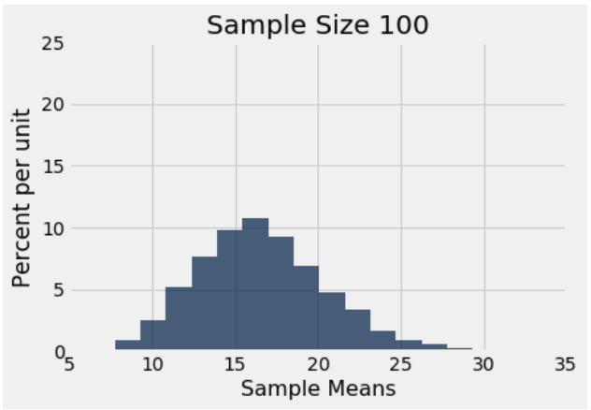
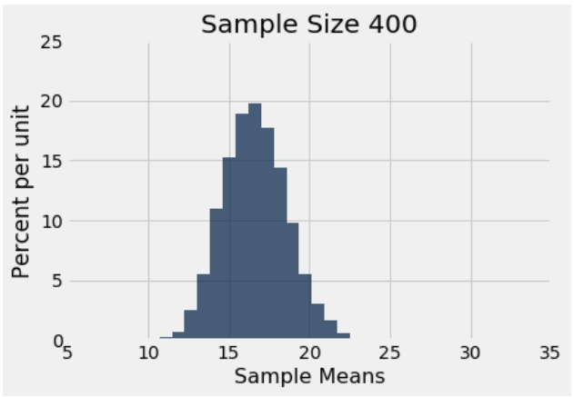
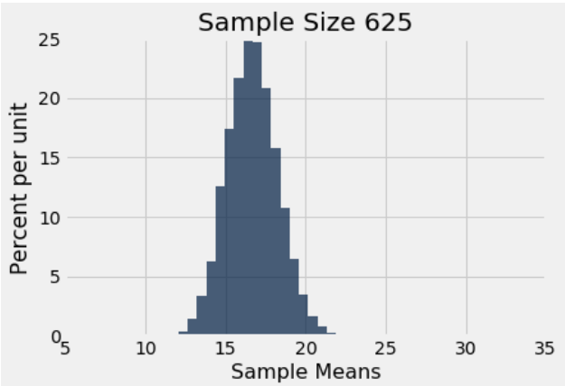
Variability of the Sample Mean
CLT tells us that the distribution of the sample means is roughly normal and centered at the population mean
SD of the sample means:
Notes:
Suggestion:
-when teaching the equation SD of all sample means = pop sd / sqrt(sample size) we recommend:
Use the example of 1 coin flip vs 1000 flips. The chance of heads will vary more for 1 flip vs 1000 flips

Slide 20
Discussion Question
How does the variability of the sample means change as sample size increases?
Will CLT work if we want to find the probability distribution of the sample max? Why or why not?

Slide 21
Discussion Question
How does the variability of the sample means change as sample size increases?
Variability decreases as sample size increases. Specifically, it decreases by a factor of sqrt(factor of increase in sample size).
Will CLT work if we want to find the probability distribution of the sample max? Why or why not?
CLT only applies to the sum or average of a sample. It does not work well when dealing with rare elements like the max.

Slide 22
Using CLT for Confidence Intervals
We can use CLT to calculate a 95% confidence interval for the population mean!
We only need the sample mean, sample size and the population SD (can approximate with sample SD)
95% confidence interval:
(sample mean - 2 SD_{sample means}, sample mean + 2 SD_{sample means})
Width of confidence interval
= 4 * (SD_{sample means}) = 4 * (SD_{population}) / sqrt(sample size)
Can choose sample size to guarantee a certain confidence interval width

Slide 23
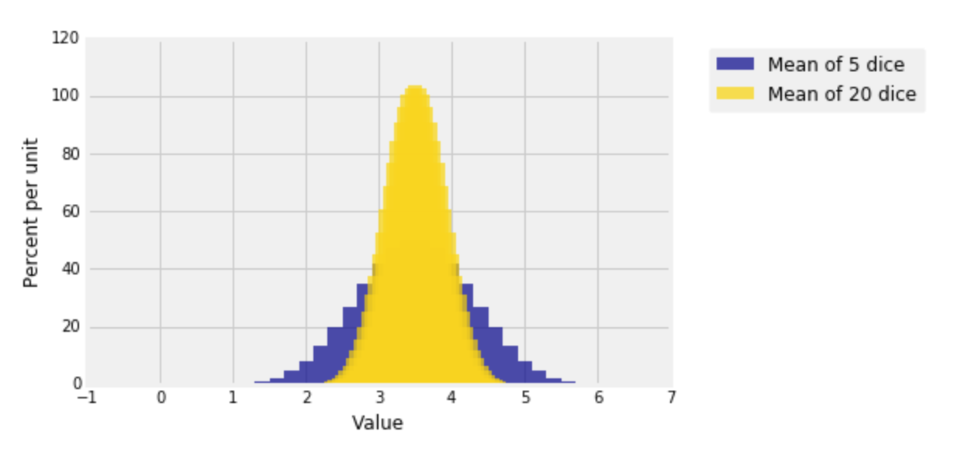
CLT Example: Dice Rolls
Satisfies the conditions for CLT
Large, random sample
With replacement
Statistic is mean
Distribution of means of 5 dice rolls
Mean ≈ 3.5
SD ≈ 1.71 / sqrt(5) ≈ 0.764
Distribution of means of 20 dice rolls
Mean ≈ 3.5
SD ≈ 1.71 / sqrt(20) ≈ 0.382
Notes:
Emphasize that “large” means different sample sizes in different contexts - it really depends on the underlying population distribution. In this case, the population distribution is uniform so it doesn’t take a very large sample size (5 or greater) for CLT to start applying. For weirder-shaped distributions, you may require larger sample sizes. Generally, a good rule of thumb is 30, but that’s not a hard rule by any means.

Slide 24
CLT Practice Problem #1
The weights of students are normally distributed with a mean of 160 pounds and a standard deviation of 30 pounds.
What is the probability that one randomly selected student will weigh more than 160 pounds?
What is the probability that one randomly selected student will weigh more than 190 pounds?

Slide 25
CLT Practice Problem #1 [Solution]
The weights of students are normally distributed with a mean of 160 pounds and a standard deviation of 30 pounds.
What is the probability that one randomly selected student will weigh more than 160 pounds?
0.5. Normal distributions are symmetric about the mean :)
What is the probability that one randomly selected student will weigh more than 190 pounds?
190 lbs is 1 std above the mean. This means 34% of the data lies between the mean and 190 lbs. We know there is a total of 50% of the data to the right of the mean. Thus we get:
50% - 34% = 16% ⇒ a 0.16 probability of selecting such a student

Slide 26
CLT Practice Problem #1
The weights of students are normally distributed with a mean of 160 pounds and a standard deviation of 30 pounds.
c. For a random sample with replacement of 25 students, what is the standard deviation of sample means?
d. Find the probability that a random sample with replacement of 25 students will have a mean weight of more than 172 pounds.

Slide 27
CLT Practice Problem #1 [Solution]
The weights of students are normally distributed with a mean of 160 pounds and a standard deviation of 30 pounds.
c. For a random sample with replacement of 25 students, what is the standard deviation of sample means?
SD of sample means = population sd / sqrt(sample_size) = 30/ sqrt(25) = 6 lbs
d. Find the probability that a random sample with replacement of 25 students will have a mean weight of more than 172 pounds.
Convert 172 lbs into standard units: (172 - 160)/6) = 2
Find what percent of data lies above 2 SD above the mean: ~2.5% (see board)

Slide 28
CLT Practice Problem #1
The weights of students are normally distributed with a mean of 160 pounds and a standard deviation of 30 pounds.
e. Which of the previous parts require the weight of students to be normally distributed in order for us to answer the question with the given information?

Slide 29
CLT Practice Problem #1 [Solution]
The weights of students are normally distributed with a mean of 160 pounds and a standard deviation of 30 pounds.
e. Which of the previous parts require the weight of students to be normally distributed in order for us to answer the question with the given information?
Parts a, b.

Slide 30
CLT Practice Problem #2
You want to estimate the average age of the United States population. You are given a large, random sample taken with replacement of 5,000 individuals in the population. You decide to construct a confidence interval for the average age by bootstrapping your sample. You bootstrap 10,000 samples and extract the average age of each bootstrapped sample, storing each average age in an array called bootstrapped_ages.
a. What is the result of calling len(bootstrapped_ages)?
b. What does each value in bootstrapped_ages represent?

Slide 31
CLT Practice Problem #2 [Solution]
You want to estimate the average age of the United States population. You are given a large, random sample taken with replacement of 5,000 individuals in the population. You decide to construct a confidence interval for the average age by bootstrapping your sample. You bootstrap 10,000 samples and extract the average age of each bootstrapped sample, storing each average age in an array called bootstrapped_ages.
a. What is the result of calling len(bootstrapped_ages)?
10,000
b. What does each value in bootstrapped_ages represent?
The average age in a bootstrap sample.

Slide 32
CLT Practice Problem #2
You want to estimate the average age of the United States population. You are given a large, random sample taken with replacement of 5,000 individuals in the population. You decide to construct a confidence interval for the average age by bootstrapping your sample. You bootstrap 10,000 samples and extract the average age of each bootstrapped sample, storing each average age in an array called bootstrapped_ages.
c. If you plotted a histogram of bootstrapped_ages, what would be its shape? What would be it centered around?

Slide 33
CLT Practice Problem #2 [Solution]
You want to estimate the average age of the United States population. You are given a large, random sample taken with replacement of 5,000 individuals in the population. You decide to construct a confidence interval for the average age by bootstrapping your sample. You bootstrap 10,000 samples and extract the average age of each bootstrapped sample, storing each average age in an array called bootstrapped_ages.
c. If you plotted a histogram of bootstrapped_ages, what would be its shape? What would be it centered around?
The histogram would be normally distributed due to CLT. It would be centered around the mean of the original random sample of 5000 individuals, and the SD of the histogram would be (SD of original sample)/(square root of 5000)

Slide 34
CLT Practice Problem #2
You want to estimate the average age of the United States population. You are given a large, random sample taken with replacement of 5,000 individuals in the population. You decide to construct a confidence interval for the average age by bootstrapping your sample. You bootstrap 10,000 samples and extract the average age of each bootstrapped sample, storing each average age in an array called bootstrapped_ages.
d. Oh no, we forgot to save bootstrapped_ages in a csv! However, we have two pieces of information: bootstrapped_ages has a mean of 28 and a standard deviation of 3 years. Construct a 95 percent confidence interval for the average age of the United States population given this information.

Slide 35
CLT Practice Problem #2 [Solution]
You want to estimate the average age of the United States population. You are given a large, random sample taken with replacement of 5,000 individuals in the population. You decide to construct a confidence interval for the average age by bootstrapping your sample. You bootstrap 10,000 samples and extract the average age of each bootstrapped sample, storing each average age in an array called bootstrapped_ages.
d. Oh no, we forgot to save bootstrapped_ages in a csv! However, we have two pieces of information: bootstrapped_ages has a mean of 28 and a standard deviation of 3 years. Construct a 95 percent confidence interval for the average age of the United States population given this information.
95% CI -> mean +/- 2SD -> (mean - 2*SD, mean + 2*SD) -> (28-2*3, 28+2*3)

Slide 36
Sample Means

Slide 37
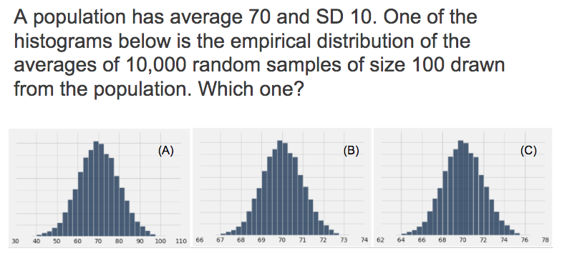
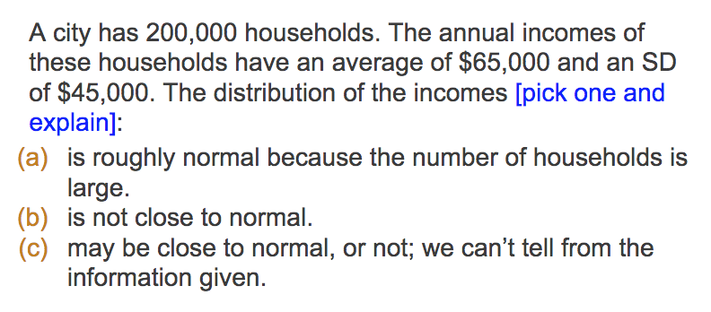
Sample Means Practice Problem #1a

Slide 38
Sample Means Practice Problem #1a [Solution]
Notes:
Centered at 70, population average
SD of this curve should be population SD / sqrt(100) = 10 / 10 = 1
Can look at the SD by looking at point of inflection (1 SD away from avg)
Also almost all of the data should be within interval of SD ± 3 SDs

Slide 39
Sample Means Practice Problem #1b
A population has average 50 and SD 10. The histogram below is the empirical distribution of the averages of 10,000 random samples of size 100 drawn from the population. What will happen to the SD of the sample averages if you increase the sample size to 1000?

Slide 40
Sample Means Practice Problem #1b [Solution]
A population has average 50 and SD 10. The histogram below is the empirical distribution of the averages of 10,000 random samples of size 100 drawn from the population. What will happen to the SD of the sample averages if you increase the sample size to 1000?
The SD will decrease

Slide 41
Sample Means Practice Problem #1c
A population has average 50 and SD 10. The histogram below is the empirical distribution of the averages of 10,000 random samples of size 100 drawn from the population. What will happen to the SD of the sample averages if you increase the number of samples to 20,000?

Slide 42
Sample Means Practice Problem #1c [Solution]
A population has average 50 and SD 10. The histogram below is the empirical distribution of the averages of 10,000 random samples of size 100 drawn from the population. What will happen to the SD of the sample averages if you increase the number of samples to 20,000?
The SD will stay about the same

Slide 43
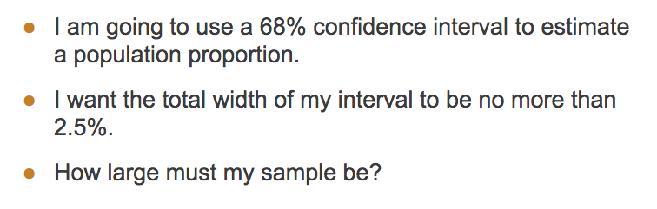
Sample Means Practice Problem #2
Assume normal distribution
Write your answer in terms of the population SD

Slide 44
Sample Means Practice Problem #2 [Solution]
68% CI = average ± 1 SD, width = 2 SDs
0.025 >= 2 * SD = 2 * population SD / sqrt(sample size)
sqrt(sample size) = 2 * population SD / 0.025
Sample size = (2*population SD / 0.025)²

Slide 45
Extra Practice Problem: Sample Means and Related Topics

Slide 46
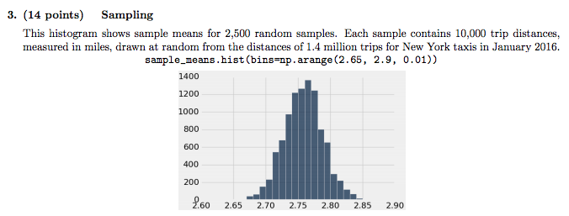
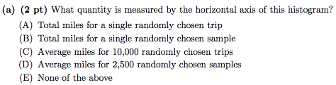
Sample Means Practice Problem #3a

Slide 47
Sample Means Practice Problem #3a [Solution]

Slide 48
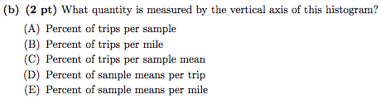
Sample Means Practice Problem #3b

Slide 49
Sample Means Practice Problem #3b[Solution]
Notes:
First, sample means, then if it were percent of sample means per trip, the bars would all have the same height! Because all samples contain 10000 trips!

Slide 50
Sample Means Practice Problem #3c

Slide 51
Sample Means Practice Problem #3c [Solution]
Notes:
Area = height*width = 1400% * 0.01 = 14%

Slide 52
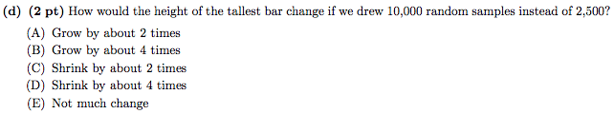
Sample Means Practice Problem #3d

Slide 53
Sample Means Practice Problem #3d[Solution]
Notes:
Increasing samples makes the empirical distribution even more similar to the probability distribution, but the shape stays the same since there are lots of samples under both scenarios.

Slide 54
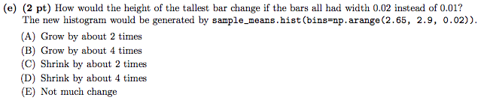
Sample Means Practice Problem #3e

Slide 55
Sample Means Practice Problem #3e[Solution]
Notes:
Since the histogram is drawn to the density scale, bar heights do not increase with the width because the density remains the same.

Slide 56
Sample Means Practice Problem #3f

Slide 57
Sample Means Practice Problem #3f [Solution]
Notes:
The SD of the distribution of sample means is about 0.03. You can see this from the inflection point of the normal curve, which is about 0.03 away from the mean. The sample mean SD is (Population SD) / √ 10000, so the population SD is around 0.03 × √ 10000 = 3

Slide 58

Sample Means Practice Problem #3g

Slide 59
Sample Means Practice Problem #3g[Solution]
Notes:
A 95% confidence interval of a normally-distributed statistic (such as a sample mean) will extend from 2 SDs below to 2 SDs above the mean: 4 SDs total. So, a width of 0.4 will come from a distribution of the statistic with an SD of 0.1. Since the population SD is 3, a sample of size 900 will have an SD of 3/ √ 900 = 0.1.

